Slide 1

EXAMINATION SYSTEM

Slide 2


Slide 3
Table of Contents
Problem Statement
Objectives
ER-Diagram & Schema
Database implementation Stored Procedures
Flask website
SSRS Reports
Power BI Dashboards
Apps Exam Screen Problems and Solutions Used Tools
Future Plan

Slide 4
What is
THE PROBLEM?
Student exam processes are traditionally:
No centralized tracking
Difficult performance measurement No real-time insights for instructors No automatic scoring
Difficult to analyze topic weaknesses
Academic institutions Suffer from:
Human error in grading Delayed results
Limited analytics

Slide 5




OBJECTIVE
Digitize the entire student examination process
Automate grading Store
answers securely
Track performance over time

Slide 6
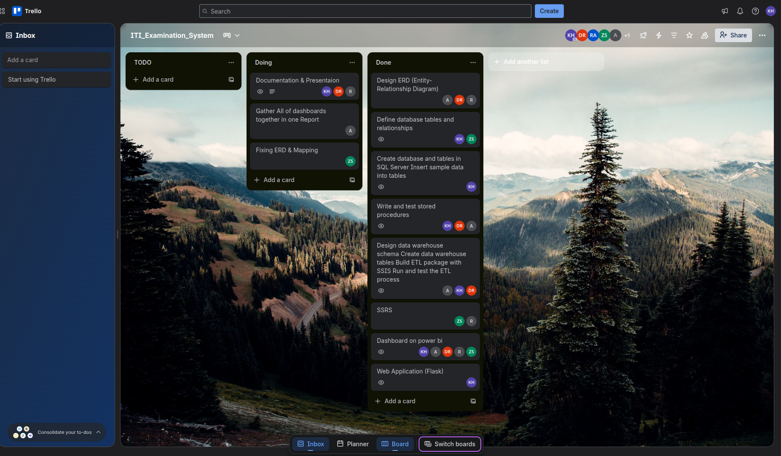
HOW DO WE MANAGE WORK AMONG US
Methodology:
Agile (2 Days - Sprint) Trello / Jira board

Slide 7
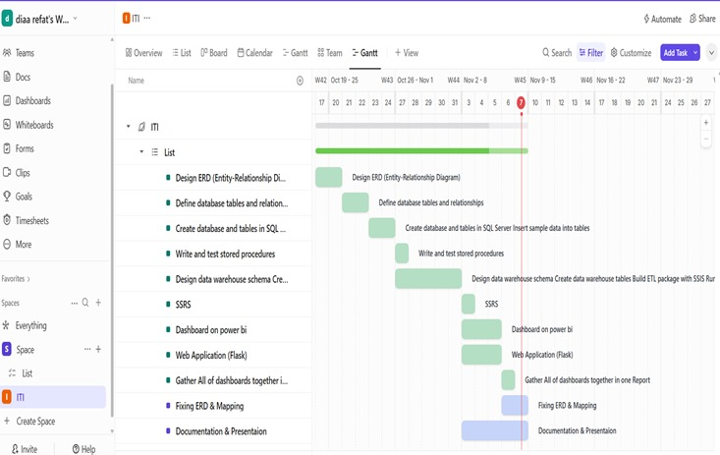
HOW DO WE MANAGE WORK AMONG US
Methodology:
Clickup
Gantte Chart

Slide 8
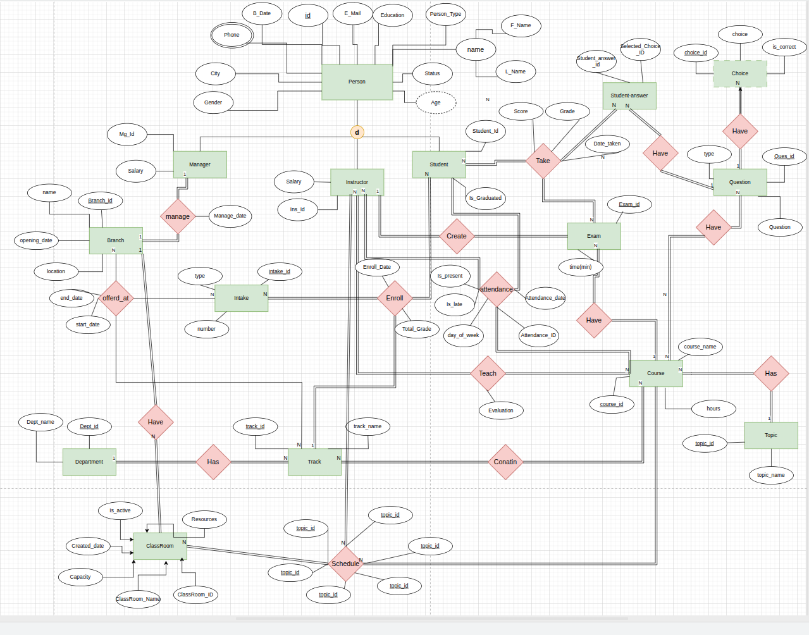
ER-DIAGRAM
We designed a relational database with carefully structured tables to ensure data integrity.
Relationships follow a 1-to-Many model in
most areas, such as students to exam answers, and courses to questions.
Normalization minimized redundancy, while lookup tables improved consistency.

Slide 9
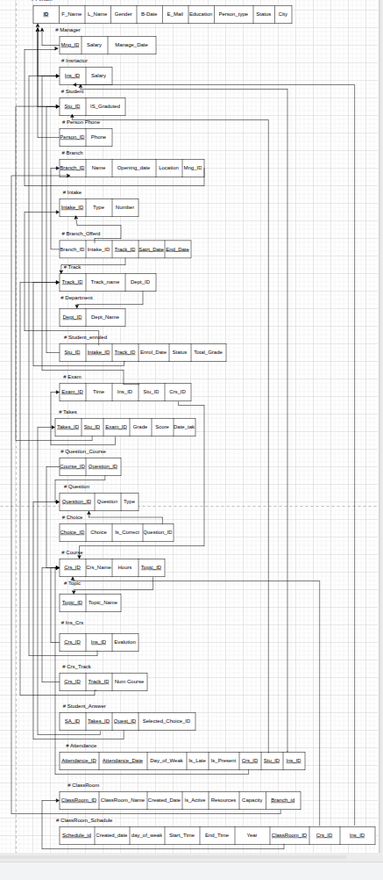
MAPPING
24 Main Table

Slide 10


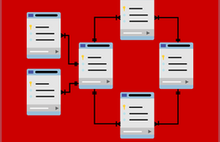


DATABASE IMPLEMENTATION
1
2
3
Technology Microsoft SQL Server
Data Types Describe the data types used for different fields (e.g., INT,VARCHAR, DATE).
Schema Diagram Outline
the schema design,
including tables, relationships)
4
5
Security Encrypted Database Objects
Backup &Recovery Daily Backup

Slide 11
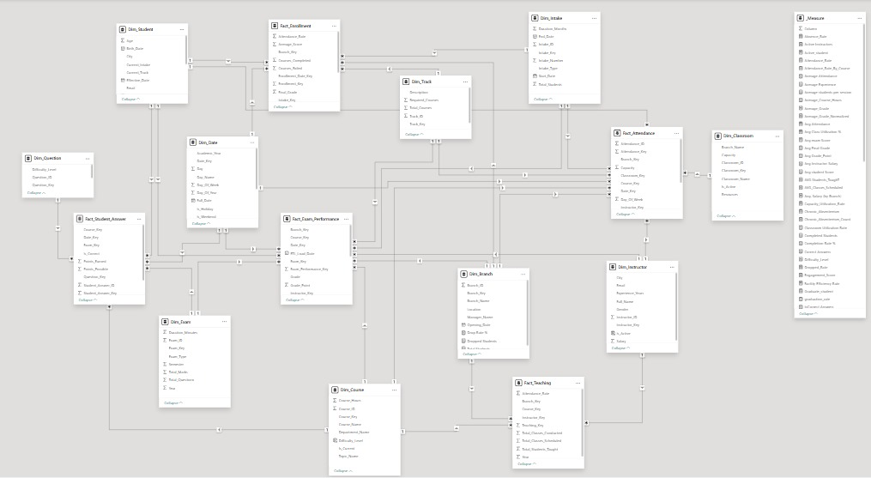
DATABASE DIAGRAM

Slide 12
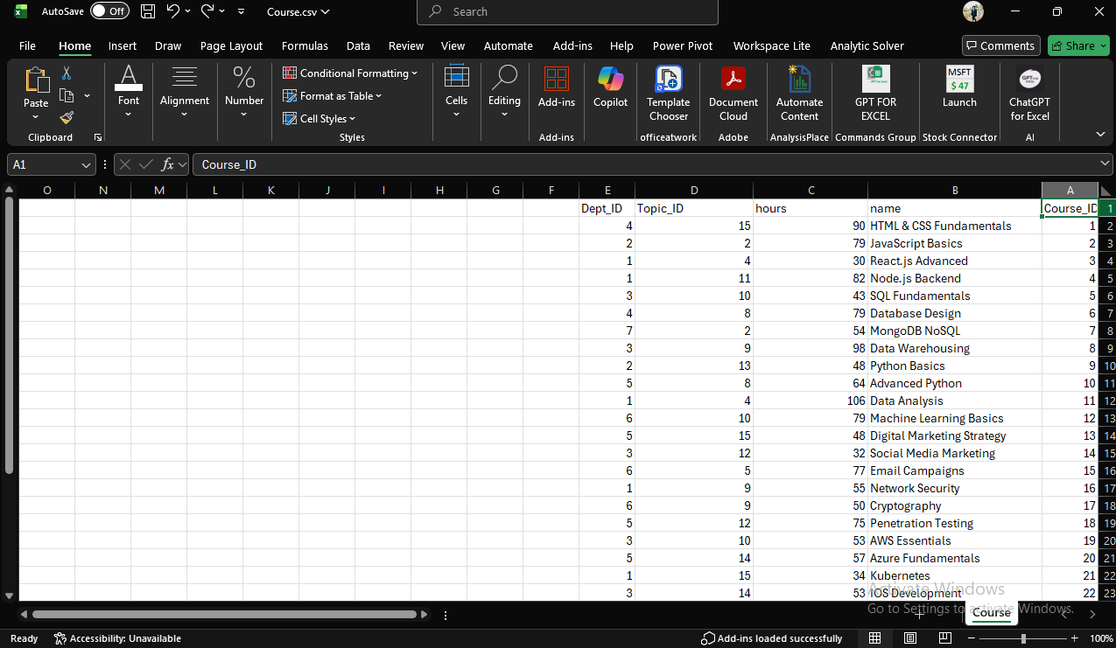

DATA FILL
AI-Generated
(Cloudera- Gemini -Perplexity - GPT)

Slide 13
We used a Galaxy Schema for our data model, which is like using more than one main table. For example, we have one fact table for exam scores and another for student enrollment.
Both of these main tables connect to the same helper tables (like DIM_Student and DIM_Course).
This setup lets us filter all our data at once. We also added a special table just for our DAX calculations to keep things fast and easy to manage.
Data Model

Slide 14
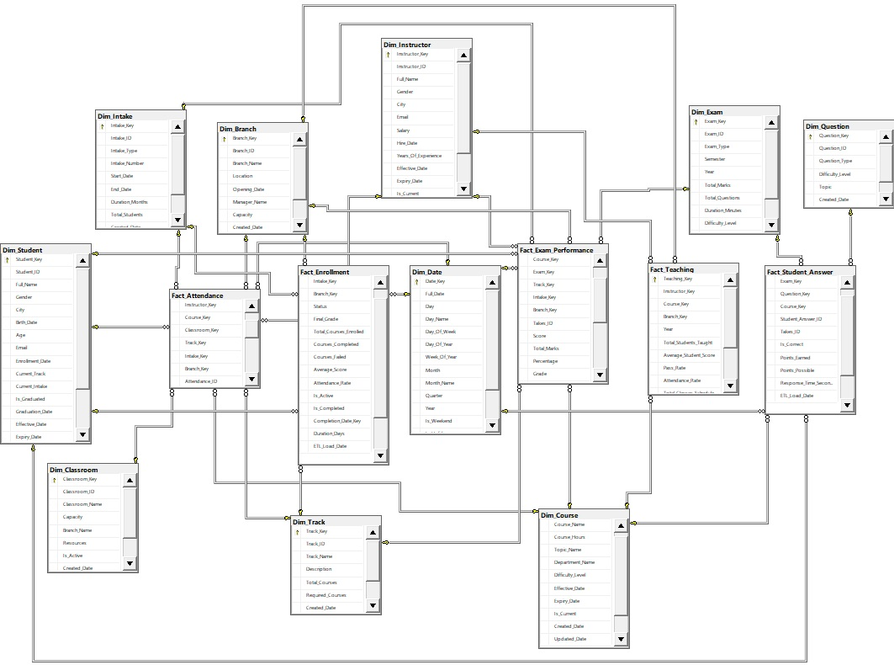
Galaxy Schema

Slide 15

SQL SERVER Integration SERVICES (SSIS)
Using SSIS in Visual Studio, we built an automated ETL pipeline that extracts, cleans, and transforms raw operational data, loading it into our Data Warehouse to make it ready for all reporting and analysis.

Slide 16
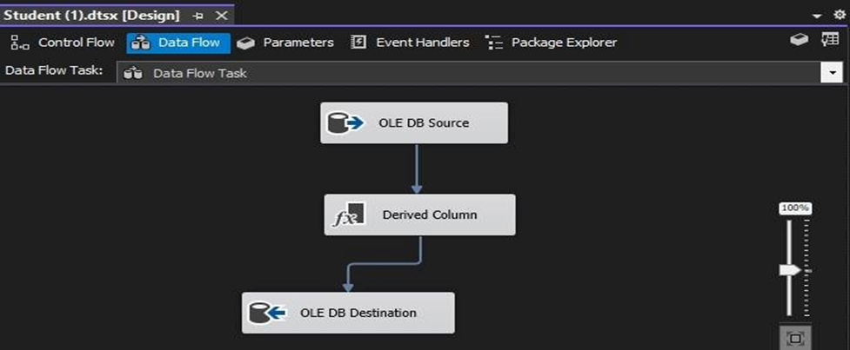
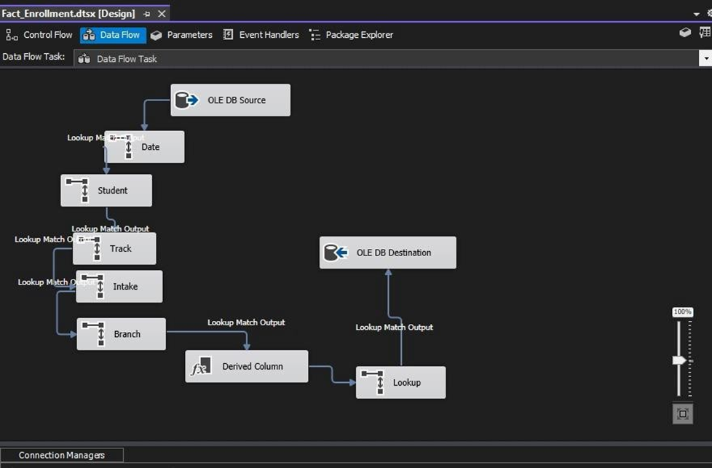
Ex Of Filling DWH Using SSIS
1-Data Flow Task(Dim_Student)
2-Data Flow Task(Fact_Enrollment)

Slide 17
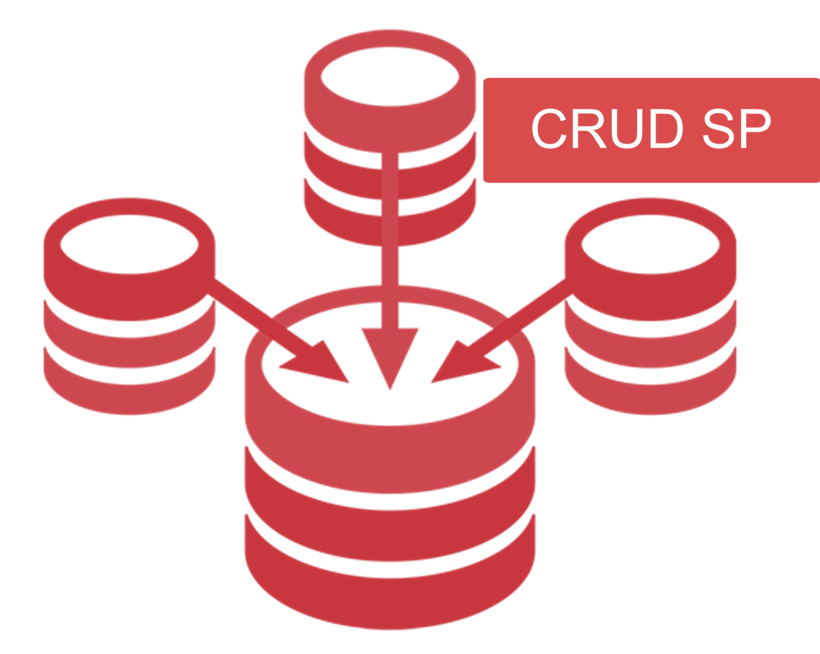
CRUD STORED PROCEDURES
They simplify and secure database operations by encapsulating the logic for Create, Read, Update, and Delete (CRUD) actions
for Each Table.

Slide 18
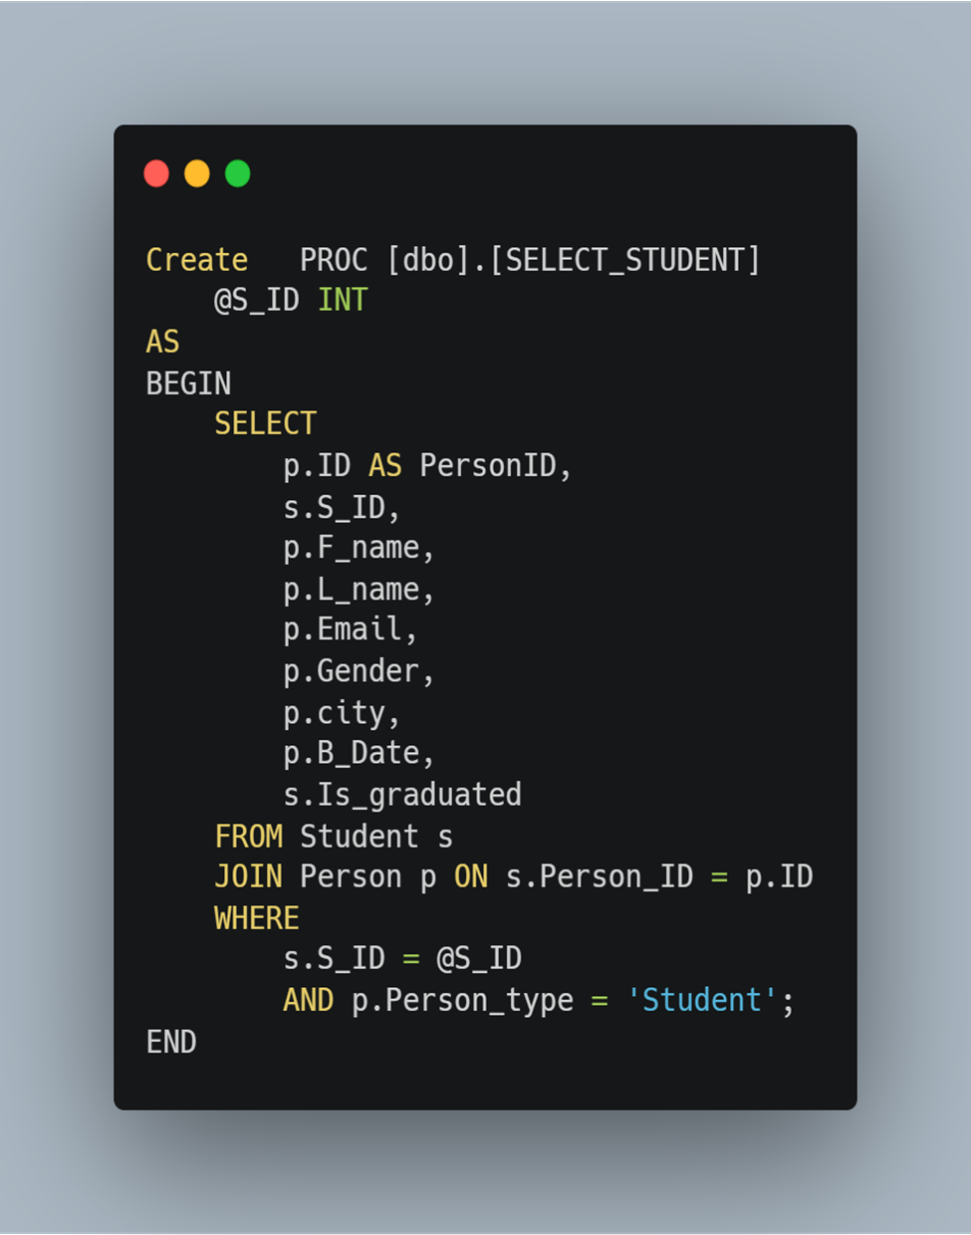
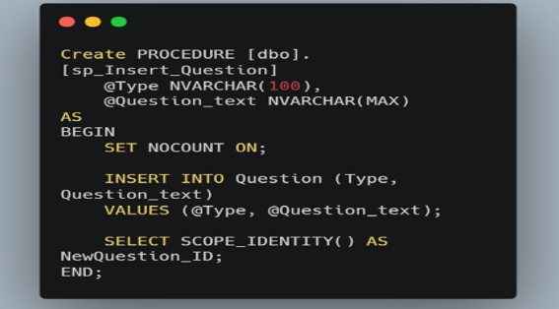
CRUD STORED PROCEDURES
Examination System
Examples
SP For Selection
SP For Insertion
Powered by ITI

Slide 19
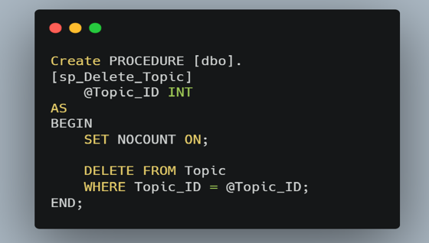
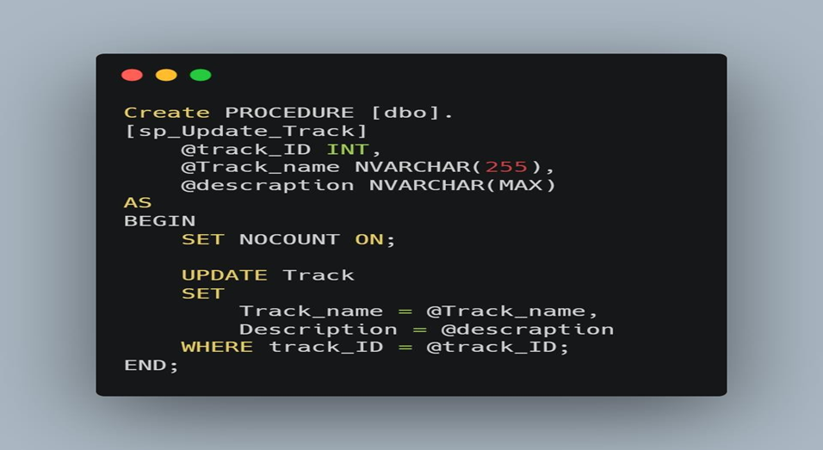
CRUD STORED PROCEDURES
Examination System
SP For Deletion
SP For Update
Powered by ITI

Slide 20
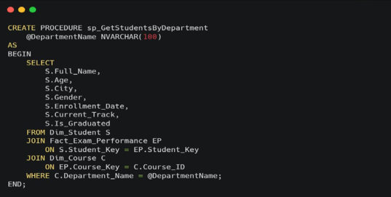
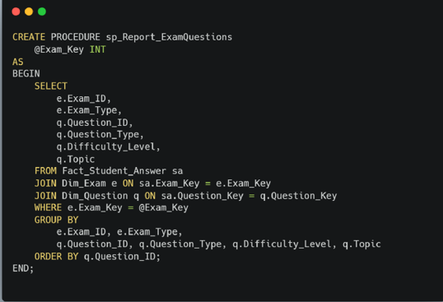
Stored Procedure for SSRS
Examination System
Students By Department
Report Exam Question
Powered by ITI

Slide 21
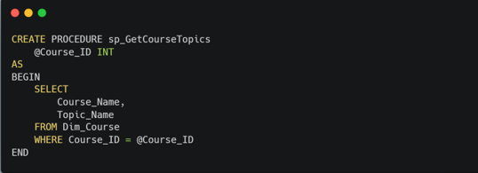
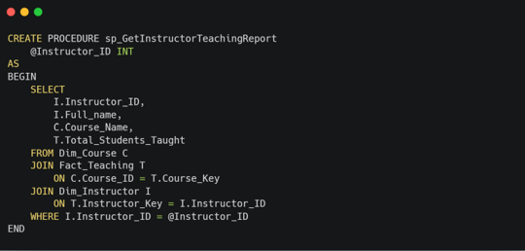
Stored Procedure For SSRS
Examination System
Get Course Topic
Get Instructor Teaching Report
Powered by ITI

Slide 22
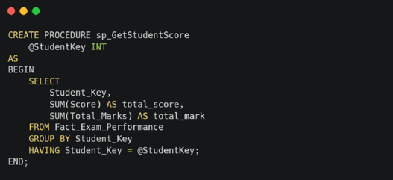
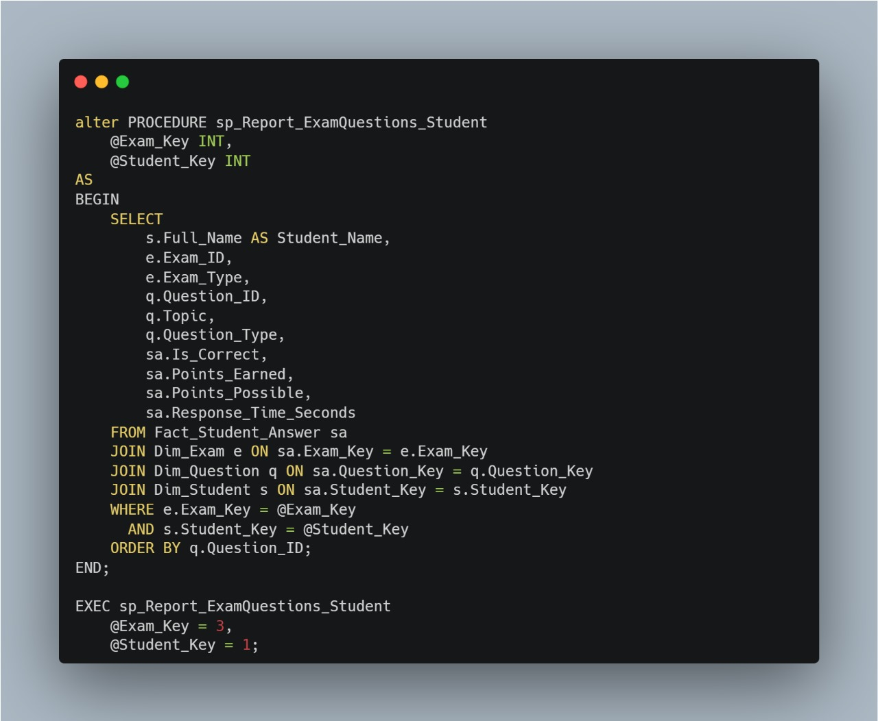
Stored Procedure For SSRS
Examination System
Get Student Course
Report Exam Question Student
Powered by ITI

Slide 23
SQL SERVER REPORT SERVICES (SSRS)
Using SSRS in Visual Studio, we created interactive reports that transform raw database
data into clear, actionable insights for students, instructors, and administrators.

Slide 24
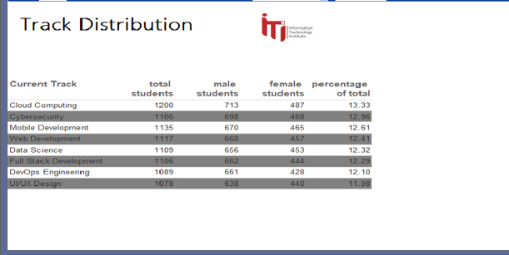
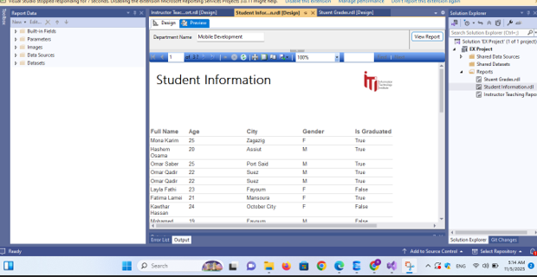
SSRS
· Report that returns the students information according to Track Distribution.

Slide 25
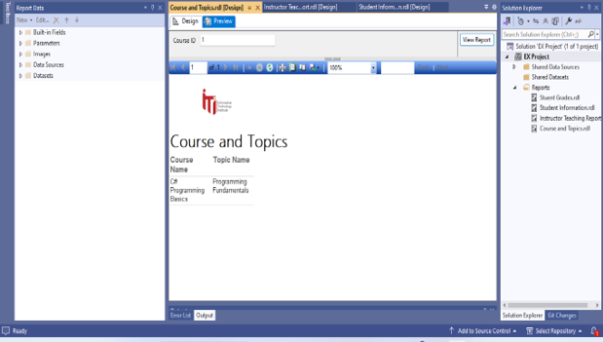
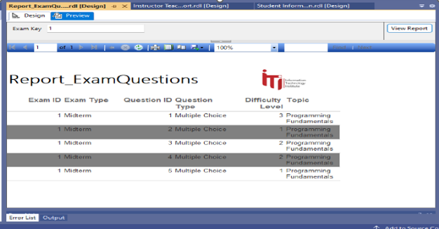
SSRS
·Report that takes course ID and returns its topics.
·Report that takes exam number and returns the Questions in it and choices [freeform report]
(GetTopicbyCourses) Procedure
(GetQuestions) Procedure

Slide 26
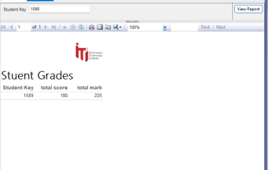
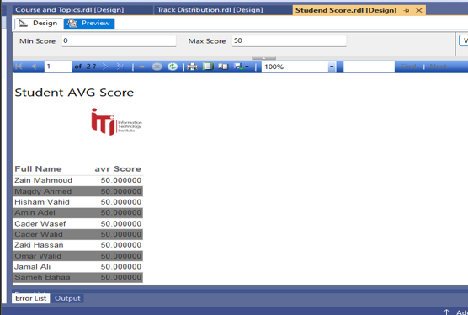
SSRS
·Report that takes the student ID and returns the grades of the student in all courses. %
· Report that takes the Student Average Score
(GetStudentGrade) Procedure

Slide 27
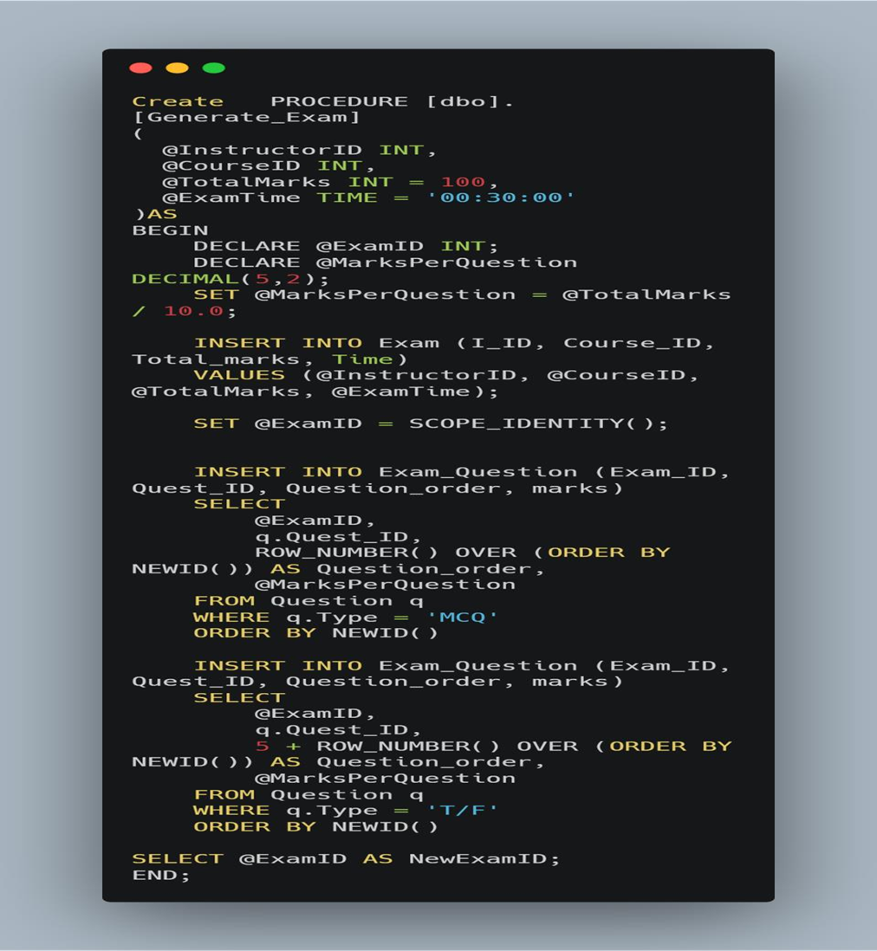
EXAM STORED PROCEDURES
Examination System
2
1
₁ Add New Exam
Powered by ITI

Slide 28
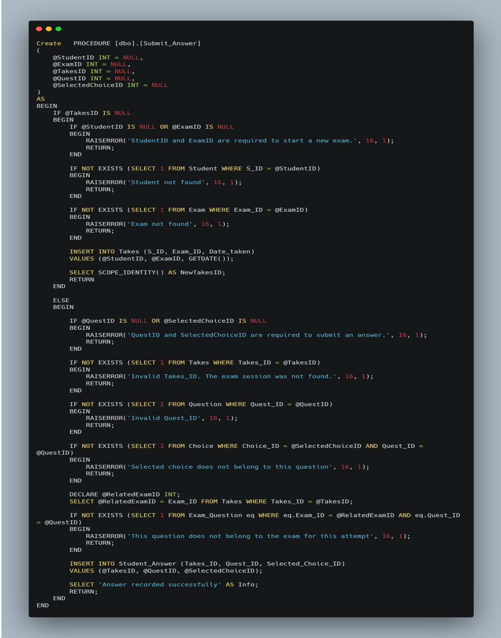
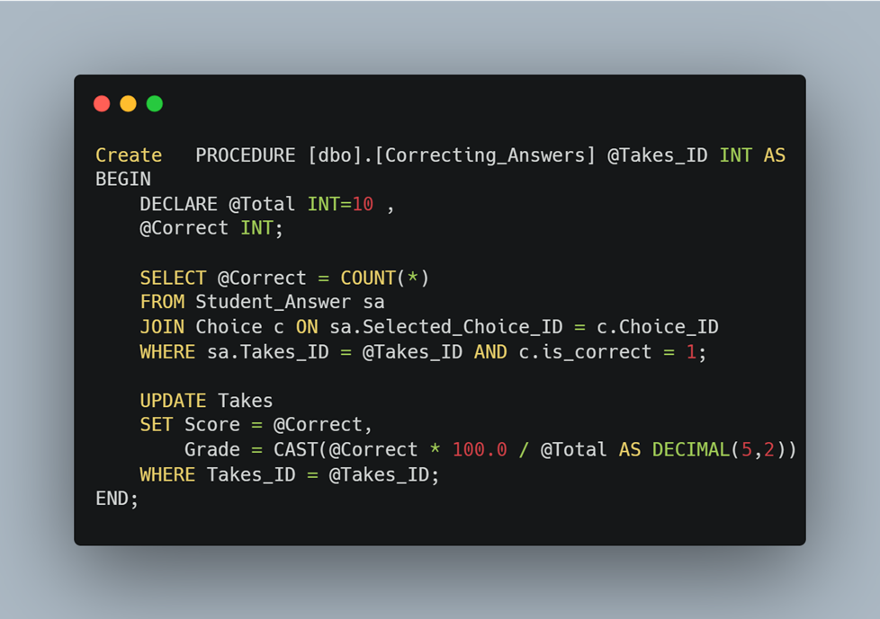
EXAM STORED PROCEDURES
Examination System
2 Submit Answer Questions
3
Correcting Answers
Powered by ITI

Slide 29
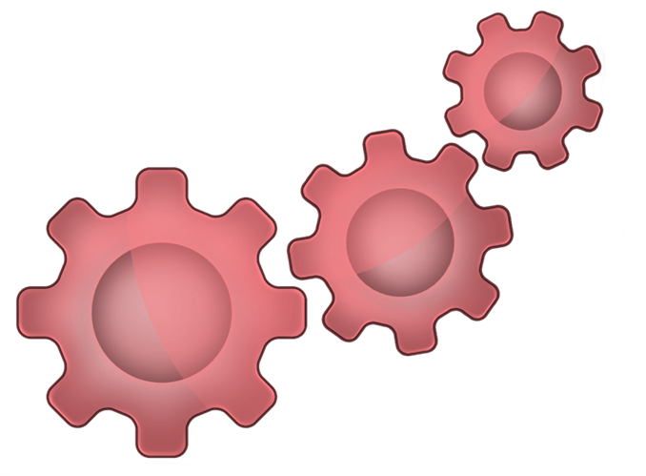


EXAM SP CHALLENGES
Handling Random Question Generation
Mapping Answers to the Correct Question Order
Preventing Multiple Exam Submissions

Slide 30

POWER BI DASHBOARD

Slide 31
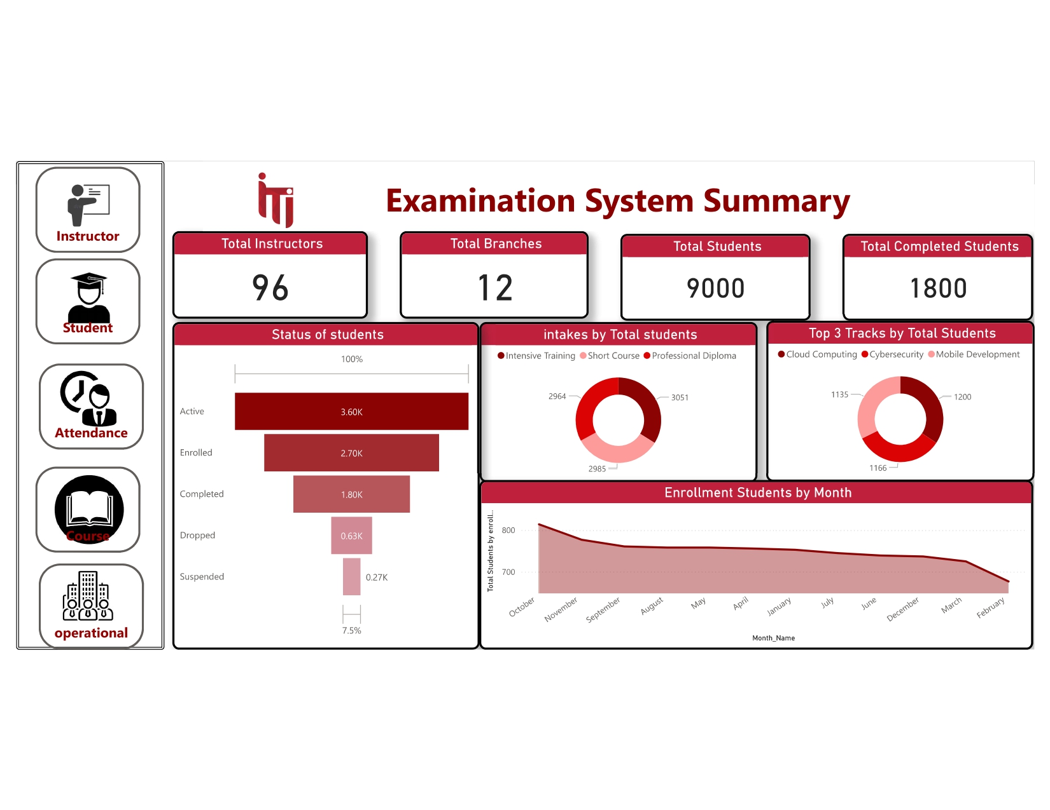
POWER BI DASHBOARD
1
OVERVIEW

Slide 32
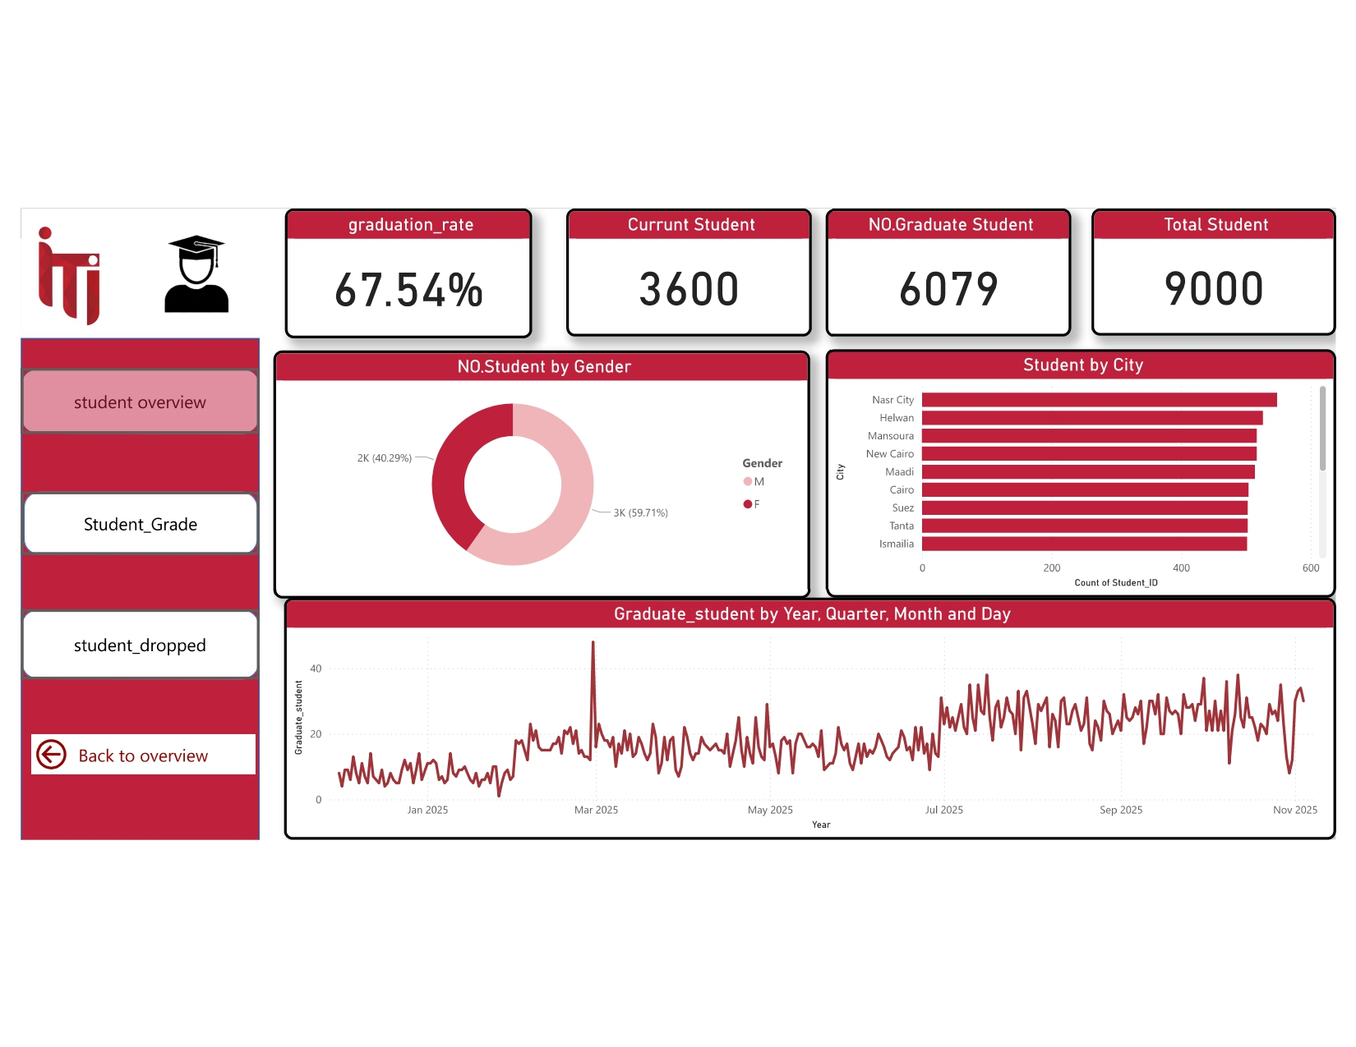
POWER BI DASHBOARD

Slide 33
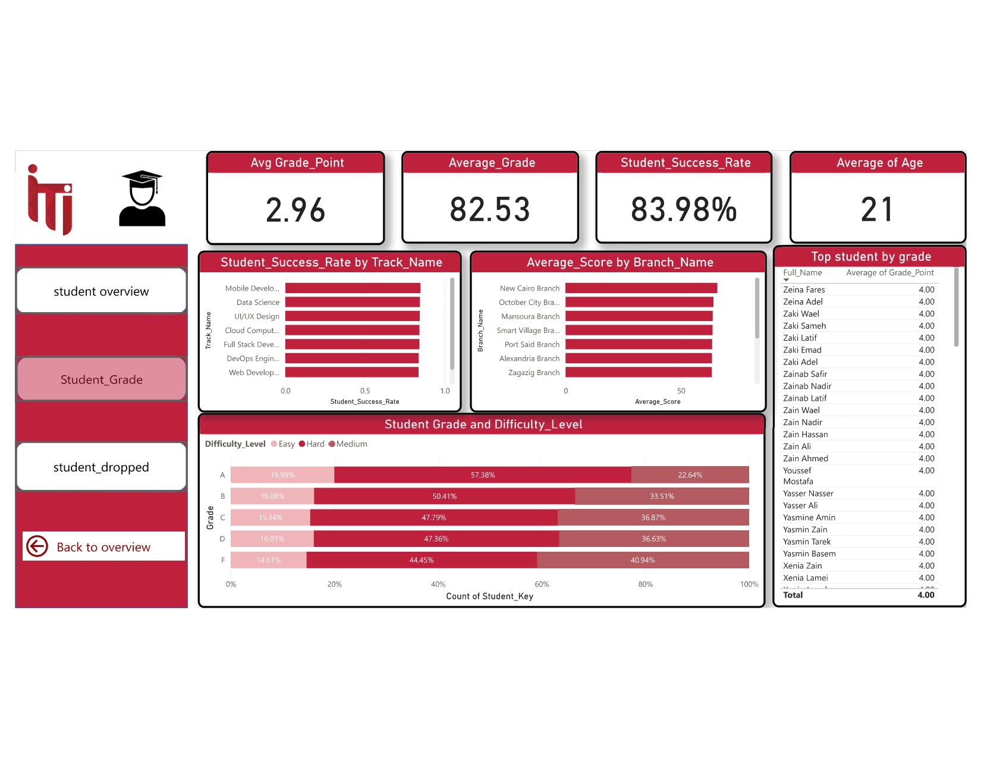
POWER BI DASHBOARD

Slide 34
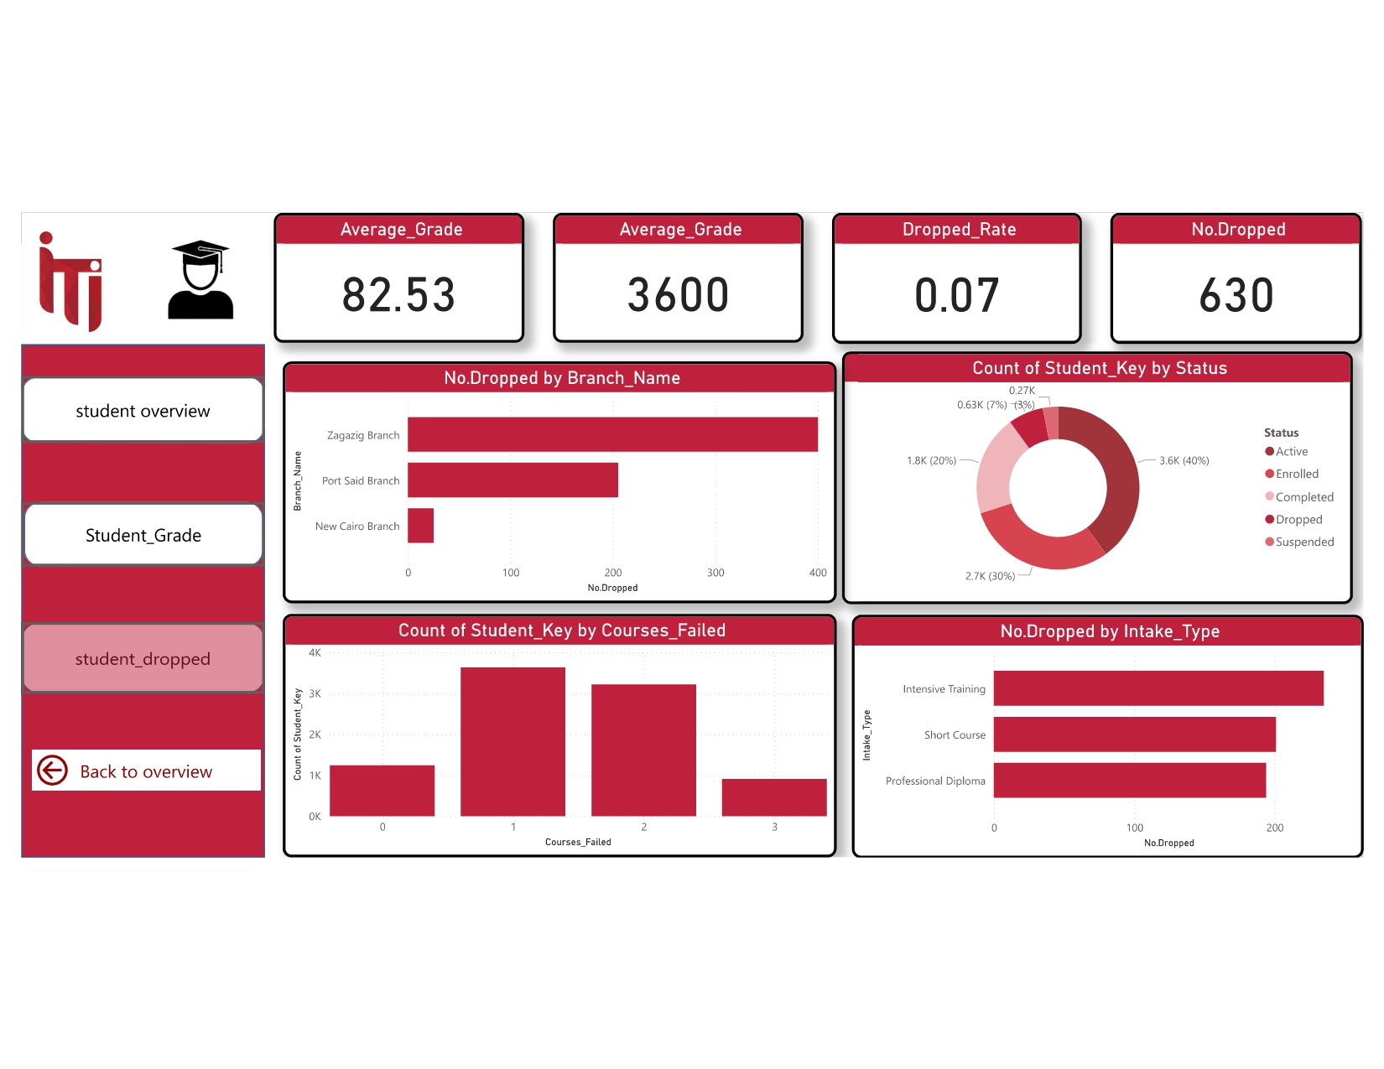
POWER BI DASHBOARD

Slide 35
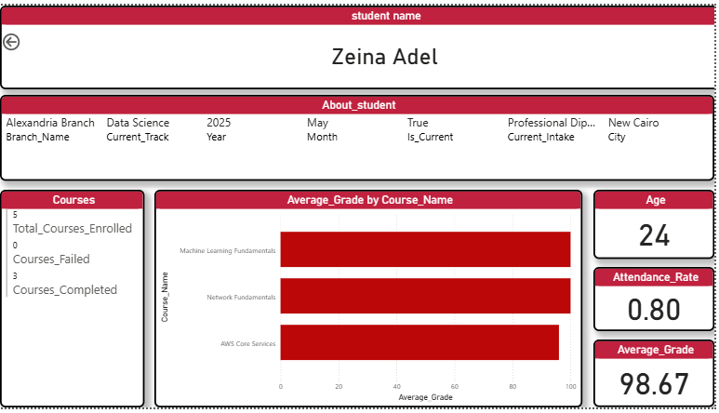
POWER BI DASHBOARD

Slide 36
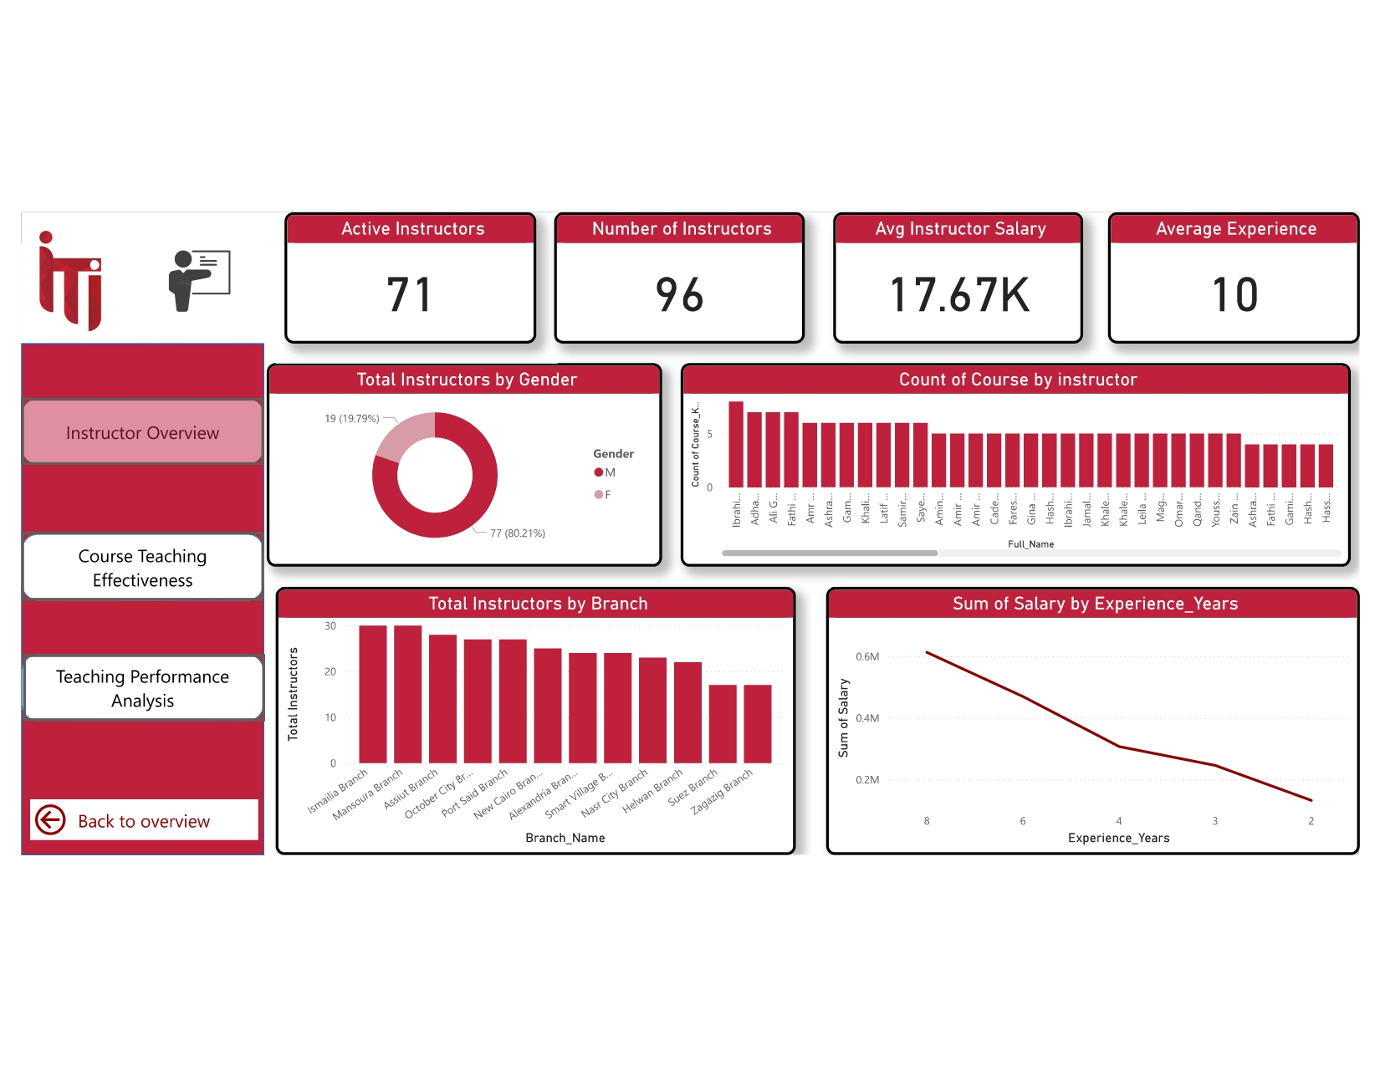
POWER BI DASHBOARD

Slide 37
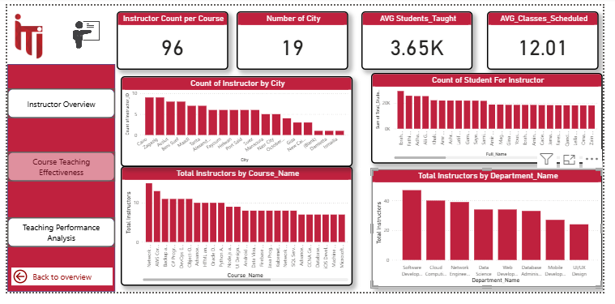
POWER BI DASHBOARD

Slide 38
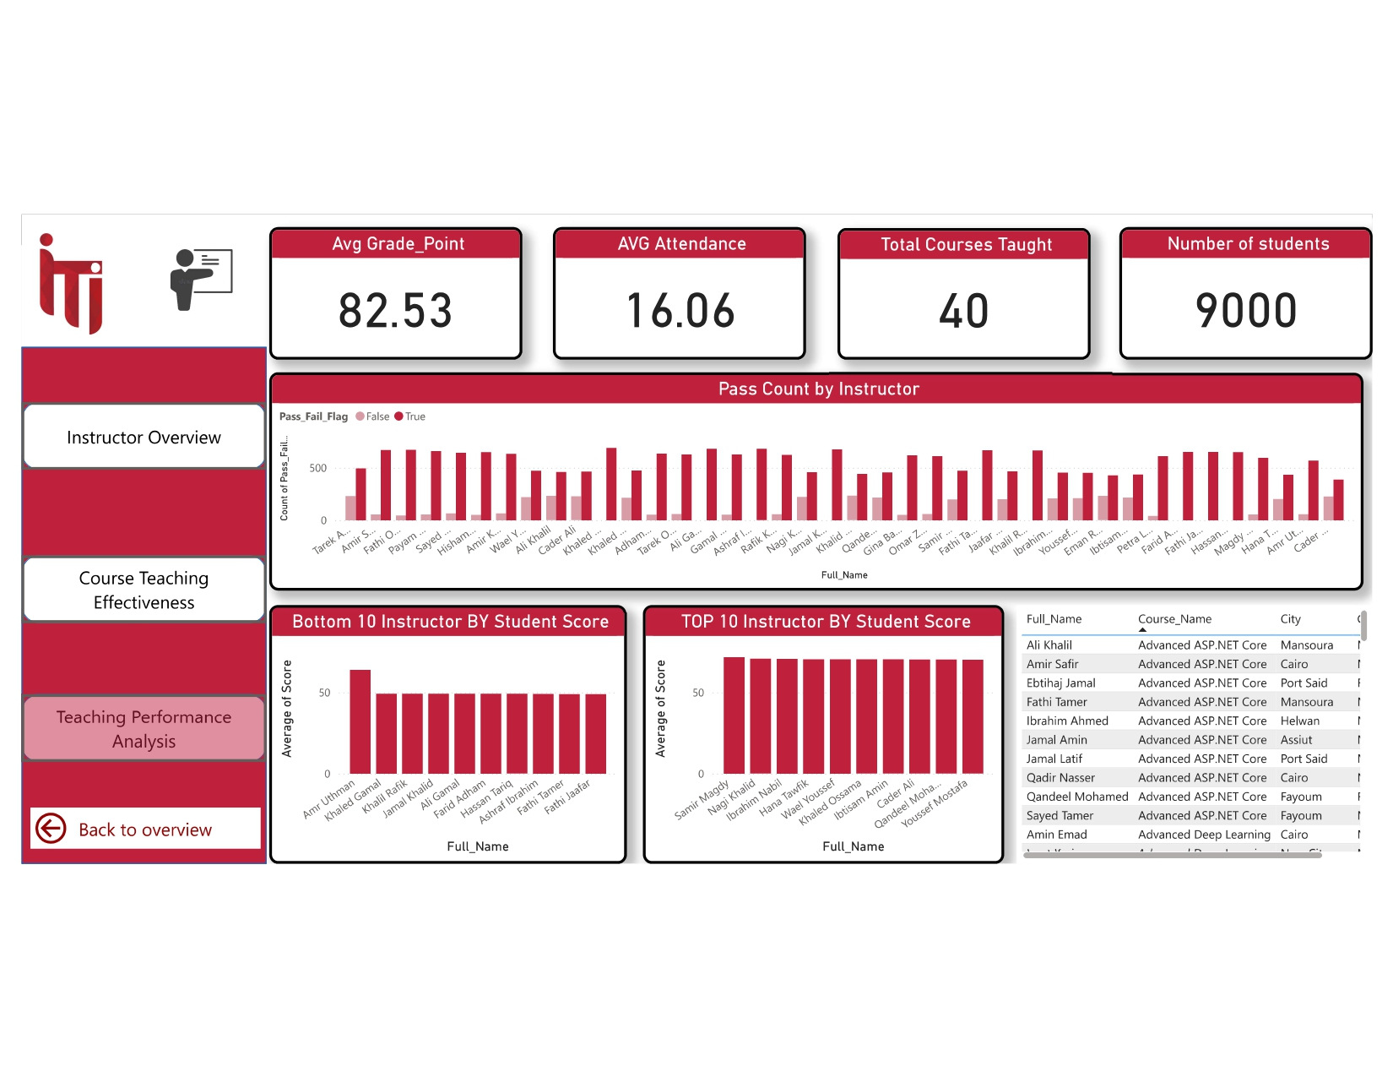
POWER BI DASHBOARD

Slide 39
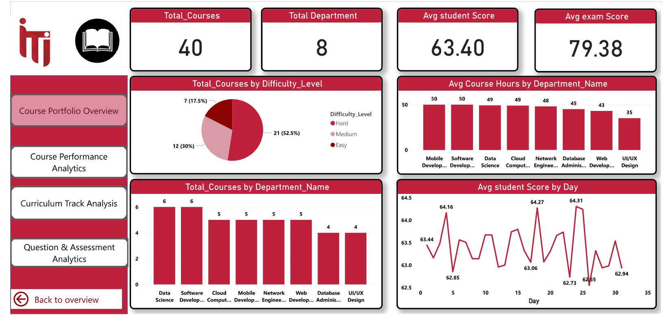
POWER BI DASHBOARD

Slide 40
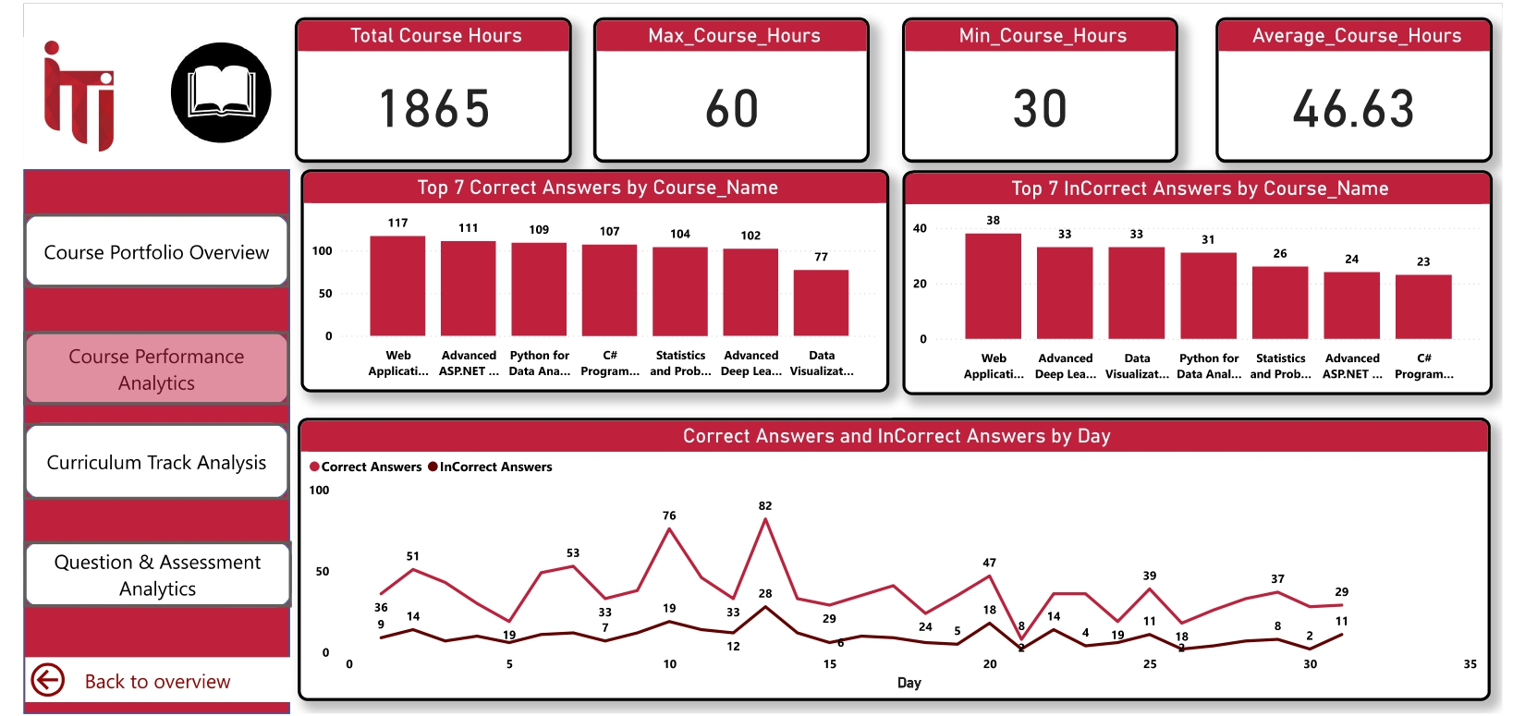
POWER BI DASHBOARD

Slide 41
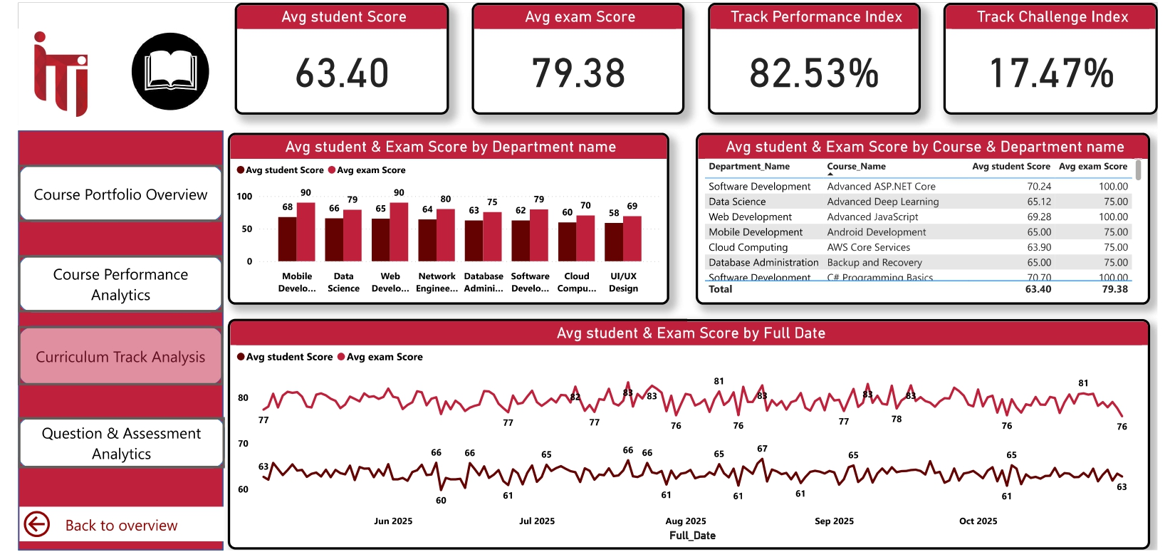
POWER BI DASHBOARD

Slide 42
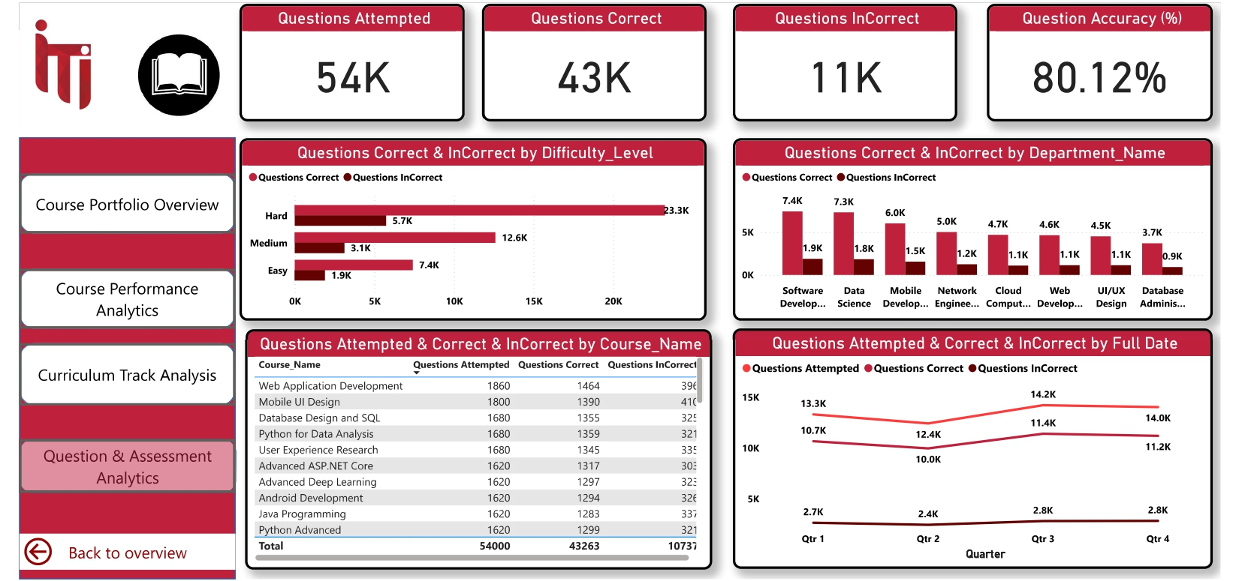
POWER BI DASHBOARD

Slide 43
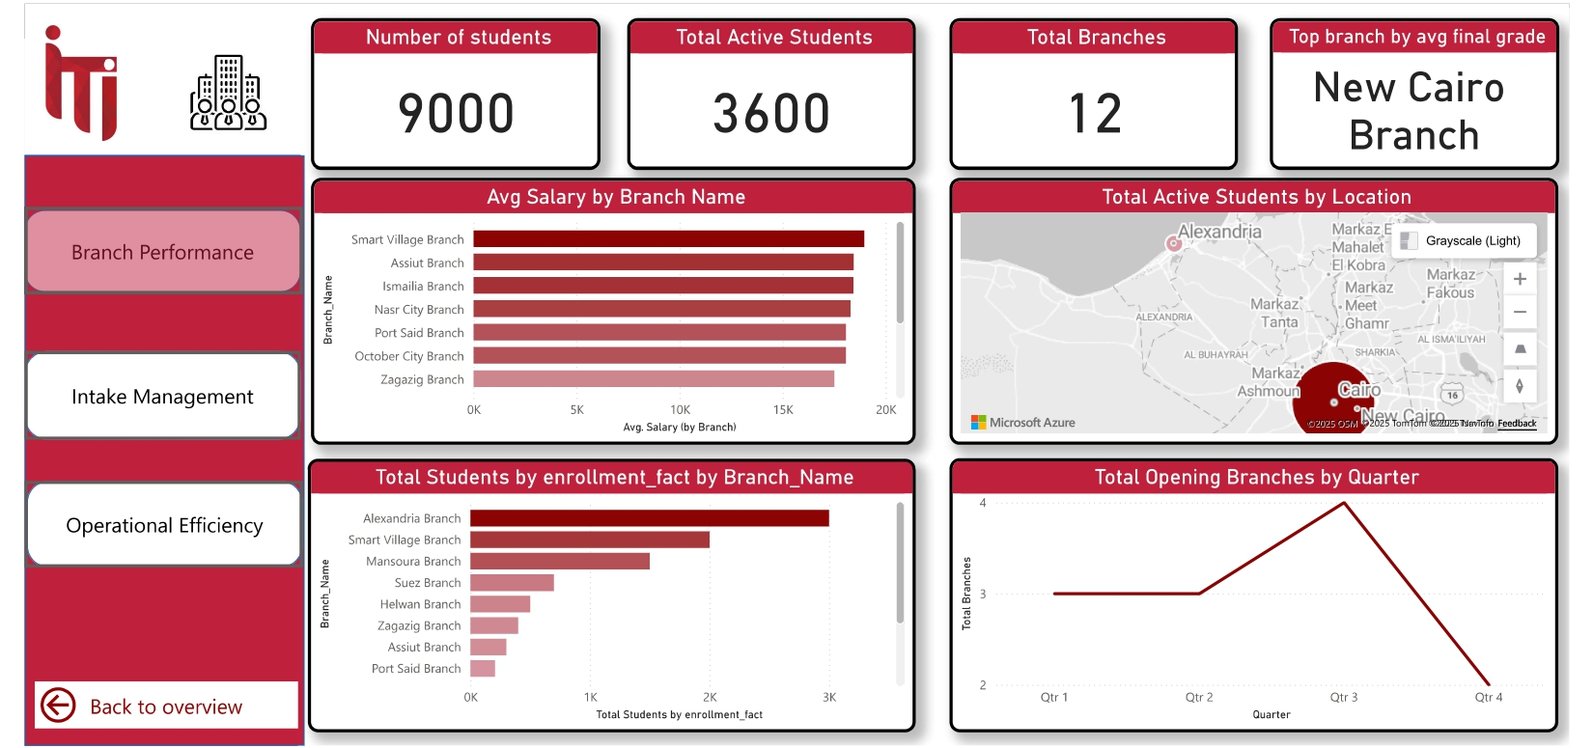
POWER BI DASHBOARD

Slide 44
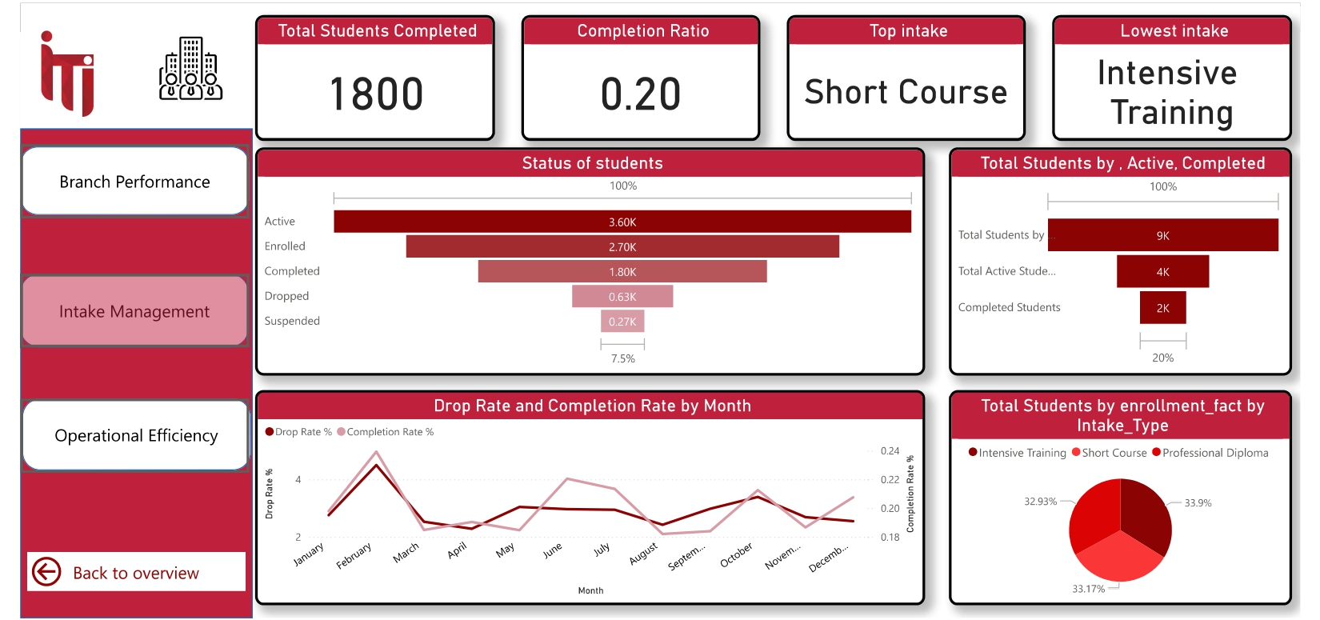
POWER BI DASHBOARD

Slide 45
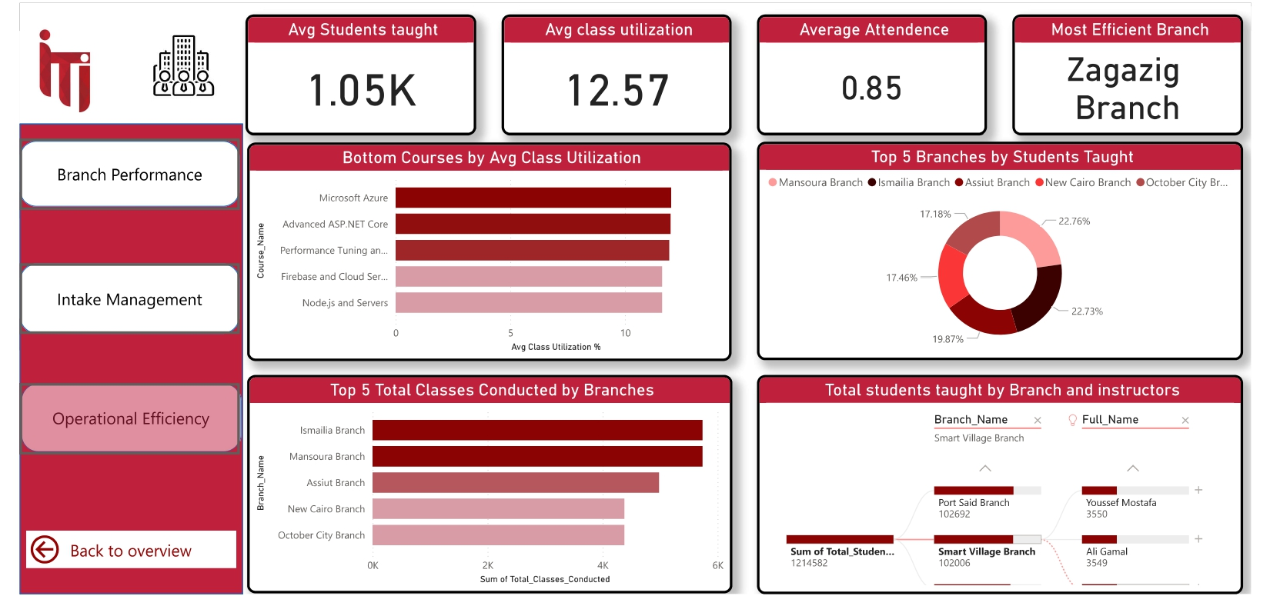
POWER BI DASHBOARD

Slide 46
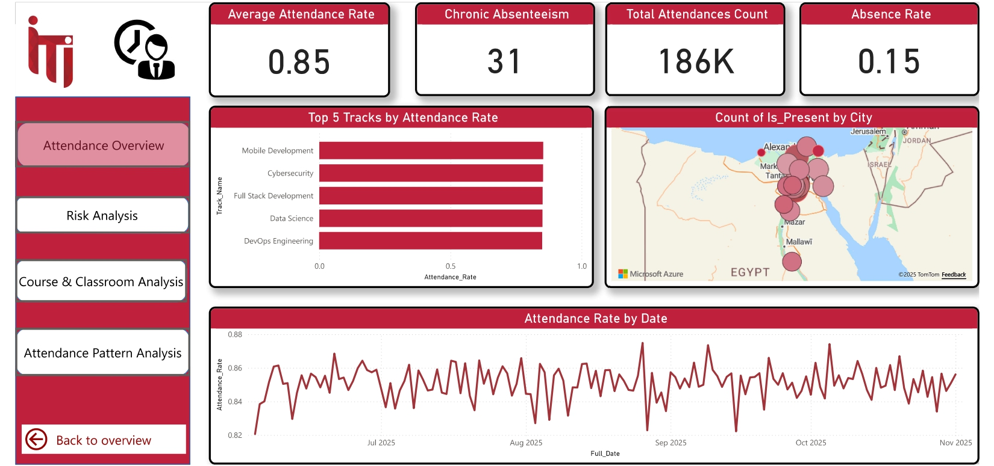
POWER BI DASHBOARD

Slide 47
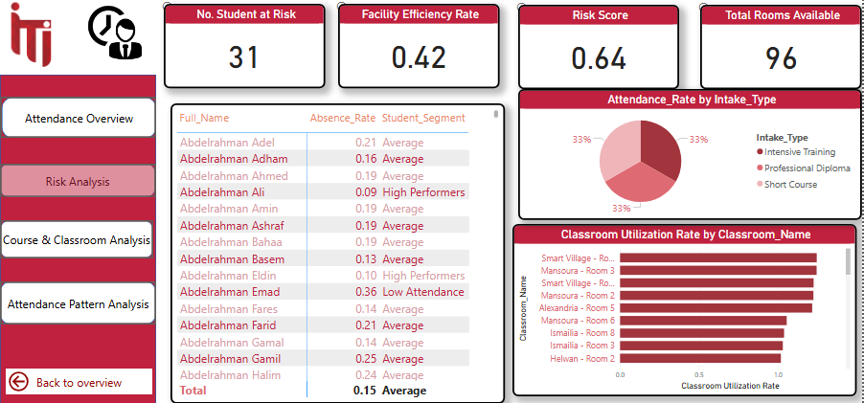
POWER BI DASHBOARD

Slide 48
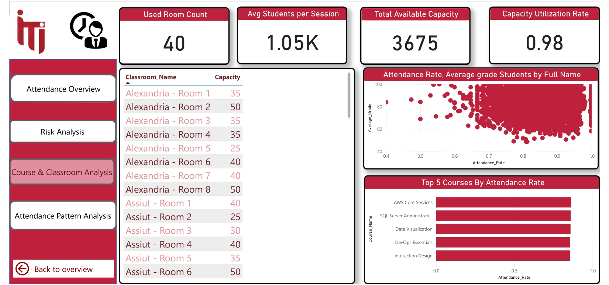
POWER BI DASHBOARD

Slide 49
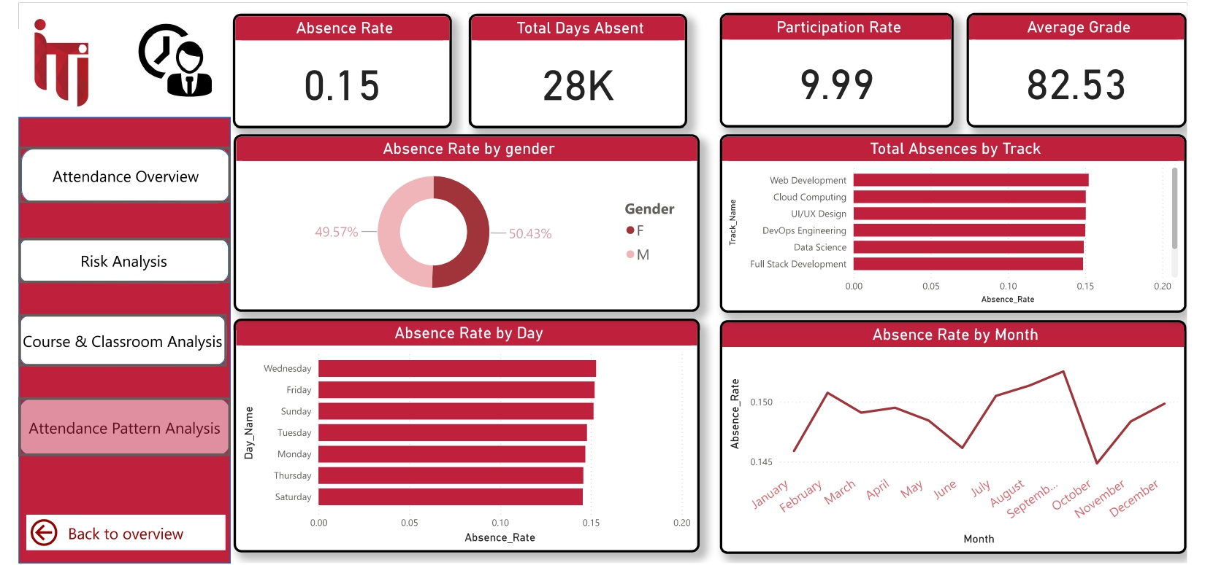
POWER BI DASHBOARD

Slide 50


WEB APPLICATION
We engineered a modular Flask web application, serving as the secure, user-friendly front-end for our comprehensive ITI Examination System. The application features a professional, role-based UI that provides tailored dashboards for Students, Instructors, and Managers. It robustly connects to our SQL Server OLTP database, executing complex stored procedures to manage the entire examination lifecycle—from dynamic exam rendering and submission to generating real-time performance analytics.

Slide 51



WEB APPLICATION

Slide 52



WEB APPLICATION
Student Dashboard

Slide 53
1
Exam Initialization: When a student picks their course, the app runs the Add_Exam and Register_Student procedures. This creates a new, personal exam record for the student in the database.
The Process
2
Dynamic Question Generation: Right after, the app calls the Generate_And_Show_Exam procedure. This automatically picks 3 random questions for that specific course, making sure every student gets a unique and fair test.

Slide 54
3
1. Interactive Answering The 3 dynamically generated questions and their choices are rendered in a clean, interactive web interface. The student makes their selections for each question, and upon completion, all answers are securely packaged and sent to the database on submission.
The Process
4
2. Automated Scoring & Results Finally, the SubmitExamAnswers stored procedure is called. This procedure instantly corrects the submitted answers against the database, calculates the final score, and saves the result to the Student_Exam table. This score is then immediately retrieved and displayed back to the student in the web interface.

Slide 55
Problems and Solutions
Problems
Unbalanced data impacting result accuracy.
Foreign key deletion constraint issue.
Difficulty choosing optimal data model
Solutions
Applied asymmetric distribution for accuracy.
Applied cascade and null strategies.
Implemented efficient Galaxy schema design

Slide 56















Used Tools

Slide 57

Future Plan
Smart Question Bank Expansion Adaptive Exam Generation Mobile Examination App
AI-assisted essay grading

Slide 58
QUESTIONS ??

Slide 59
THANK YOU

